Slide 1

TOPMed Analysis Workshop
Genetic Analysis Center
Biostatistics Department
University of Washington
TOPMed Data Coordinating Center
August 7-9, 2017
Introductions

Slide 2
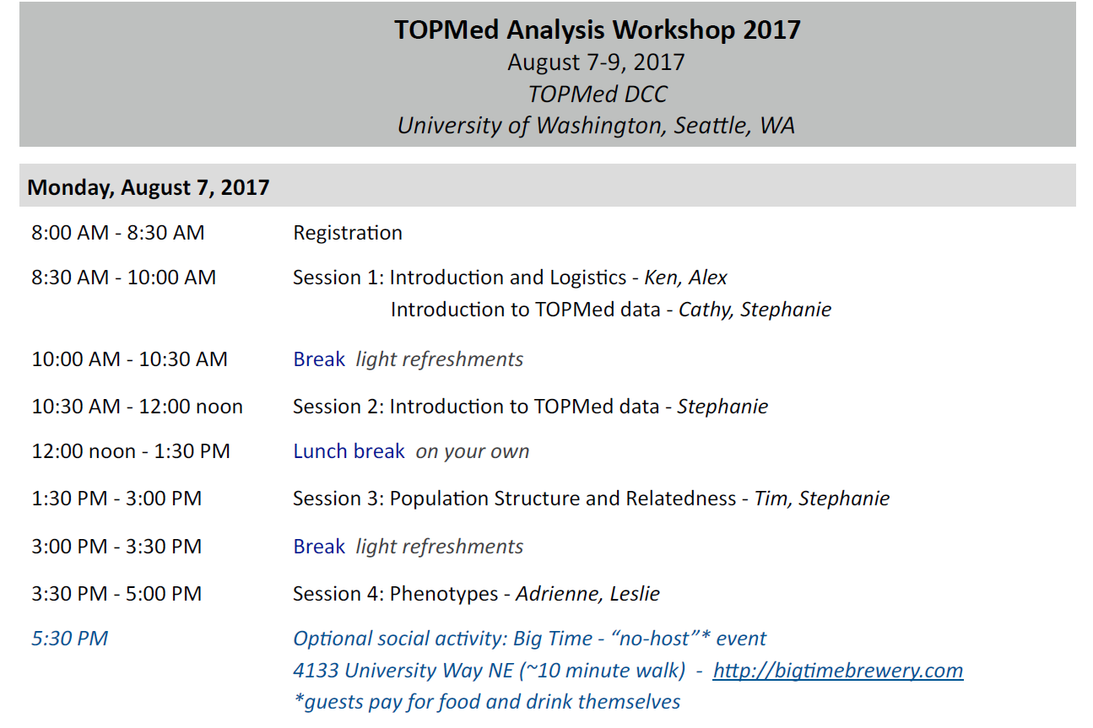
Schedule Overview

Slide 3
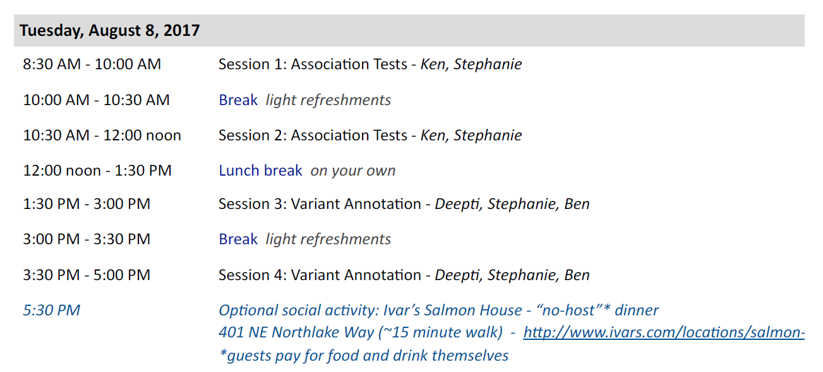
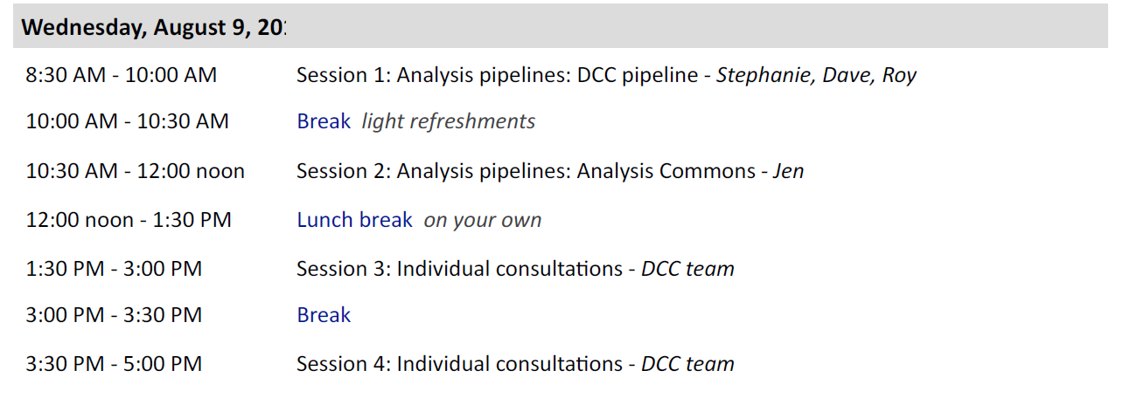
Schedule Overview

Slide 4
Connectivity
Wireless Connection: UW NetID: event0216
Password: v5X7-c9H8-t8J2
Slides:
https://www.nhlbiwgs.org/topmed-analysis-workshop-2017-materials
Hands-on:
https://uw-gac.github.io/topmed_workshop_2017
Slack channel: (sign up!)
https://join.slack.com/t/topmed-analysis-2017/signup
…contact bheavner@uw.edu for help with slack

Slide 5
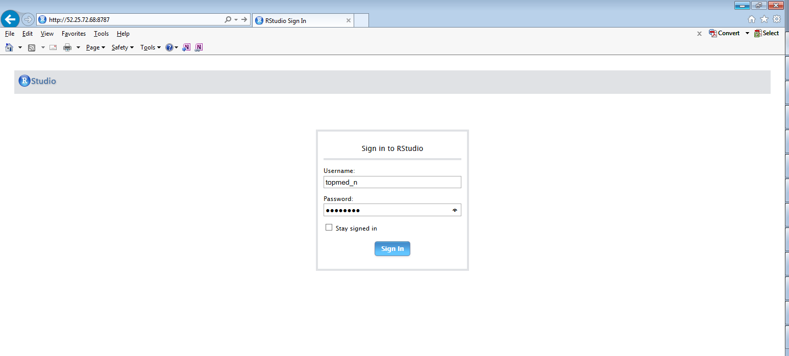
Log-in to Amazon Web Services
http://52.25.72.68:8787
topmed_n
Topmed_n

Slide 6
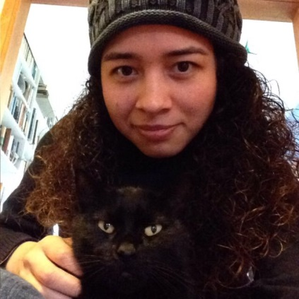
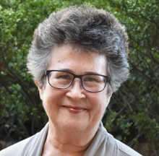
Workshop Outline and People
Introduction to the workshop –Mon AM
  a. UW GAC people
  b. Logistics
Ken Rice
Associate Professor
TOPMed DCC PI
Alex Garcia Lugo
Coordinator
Michael Bowers
Coordinator
Kate Wehr
Coordinator

Slide 7
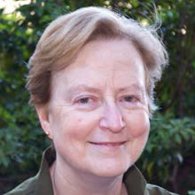
Workshop Outline and People
Introduction to TOPMed Data – Monday AM
a. Overview and data access
b. Genotypes
Cathy Laurie
GAC Co-Director
Stephanie Gogarten
Research Scientist

Slide 8
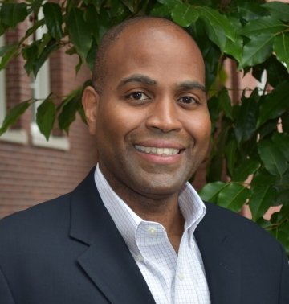
Workshop Outline and People
Population Structure and Relatedness – Mon PM
Tim Thornton
Associate Professor
Stephanie Gogarten
Research Scientist
Phenotype harmonization – Mon PM
Adrienne Stilp
Research Scientist
Leslie Emery
Research Scientist

Slide 9
Workshop Outline and People
Association testing – Tues AM
Ken Rice
Associate Professor
TOPMed DCC PI
Stephanie Gogarten
Research Scientist
Variant annotation – Tues PM
Ben Heavner
Research Scientist
Deepti Jain
Research Scientist

Slide 10
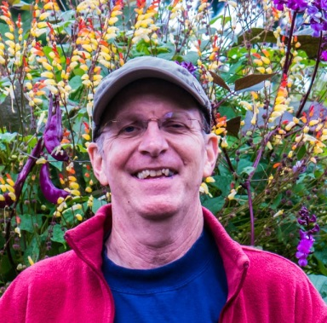
Workshop Outline and People
UW Genetic Analysis Center Pipeline – Wed AM
Stephanie Gogarten
Research Scientist
Dave Levine
Research Scientist
Roy Kuraisa
Computer Scientist
Statistical Analysis Commons Cloud – Wed AM
Jen Brody
Research Scientist

Slide 11
Workshop Outline and People
Additional GAC faculty/staff on hand to help and advise
Bruce Weir
Professor
TOPMed DCC PI
Cecelia Laurie
Research Scientist
Xiuwen Zheng
Research Scientist
Quenna Wong
Research Scientist
Tamar Sofer
Research Scientist

Slide 12
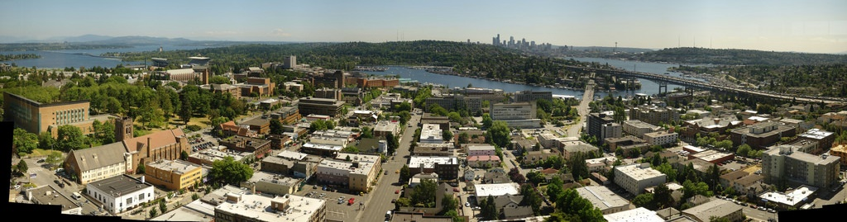
Other essentials
This room will not be locked
Restrooms are available down the hallway
Lunch options – to follow! Or follow a local…
Bags on final day (Light Rail to airport beats taxis…)
We are hiring! – see Ken/Cathy/Bruce for postdocs and/or staff scientist positions

